Slide 1
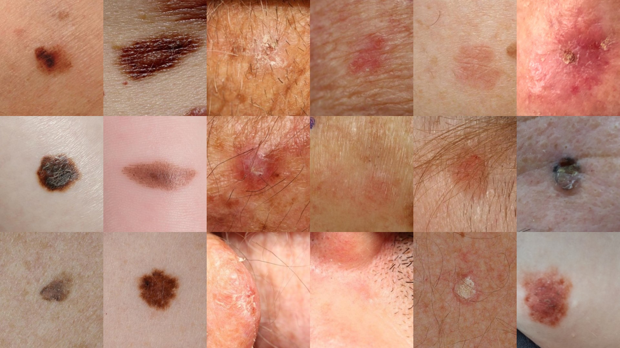
Skin Lesion Triage
BIU DS23 CAPSTONE
Re-ordering the dermatology waiting list by risk
Ifat Davidson · Yuval Rubenchuk · Roi Budnitsky · Tami Khazma
Notes:
One-line pitch: a phone photo and six questions re-order a dermatologist’s waiting list so the patients who cannot wait are seen first. Team roles: Ifat, product; Yuval, data; Roi, model; Tami, agent. The system does not diagnose; the dermatologist decides every case. The photos behind the title are real training images from the ISIC and PAD-UFES-20 datasets.

Slide 2
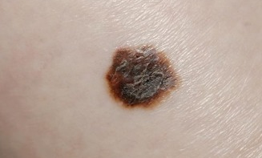
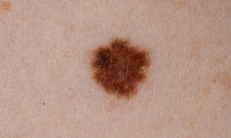
Same queue.
Same wait.
02 · BACKGROUND AND NEED
24.5
Melanoma · booked today
median days to a dermatologist in Israel
+8.5 days every year · 40+ in Tel Aviv
Benign mole · booked yesterday
Notes:
Business problem: a health-fund dermatologist sees patients in arrival order, and nothing in the list tells which lesion cannot wait. Online dermatology services exclude moles, so these patients must wait for an in-person visit. The two photos make the point: a melanoma booked today waits behind a benign mole booked yesterday. Value is measured in days of delay for malignant lesions. Figures from the project charter.

Slide 3
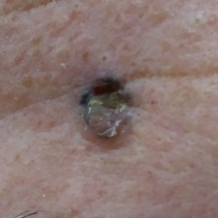


Three users, one daily cycle
03 · PRODUCT AND SOLUTION
Patient
System
Dermatologist
Uploads a photo
Answers 6 questions
Never sees a score
Ranks the queue daily
Flags the top 10%
Prepares evidence
Reviews the list
Moves cases earlier
Makes every decision
Not a diagnosis tool. It can only move a patient earlier.
Notes:
Product understanding before technology. The user is a health-fund dermatologist with an overloaded queue; the patient is someone already on the waiting list. The patient’s job is small: a photo and six yes/no questions in the app they already use, and they never see a score or a diagnosis. The system runs every morning: it ranks the whole queue, flags the top 10% and prepares evidence for each flagged case. The dermatologist keeps every decision: move the appointment earlier, refer for biopsy, or keep the regular slot. The product changes who is seen first, nothing else.

Slide 4









How it flows
04 · PROCESS FLOW
Data
Models
Ranking
AI agent
Report
Decides 1 of 5 actions
Checked by code
Fails → manual review
Notes:
Data: photo, six answers, age and body site. Models: ConvNeXt image score and a questionnaire score. Ranking: 60/40 fusion on percentile ranks; the top 10% of the queue is flagged. The agent comes after the ranking. What it decides: one of five actions (proceed, proceed with a flag, request a photo retake, ask the patient a question, manual review); never the score or the rank. Who checks it: plain code after every answer (under 18, missing data, unverified citations, reassuring words). What happens when it fails: one retry, 120-second timeout, then manual review with a fixed model summary; priority unchanged and the report still ships.

Slide 5



What it takes to run
05 · WHAT IT TAKES
Data
Stack
People
Photo · 6 answers
Age · body site
Waiting list
1 small CNN
Vector index
LLM API
Dermatologist
Priority slots
Photo review
Notes:
Data: what the app already collects plus the waiting-list export; photo quality is labelled by hand for now. Stack: a ConvNeXt-Tiny image model, a logistic-regression questionnaire model, a local Chroma index over the NCI PDQ guidance, and an LLM API (Gemini), run as a daily batch. People and process are the real dependency: the dermatologist reviews about 10% of the list, the clinic must reserve priority slots, and someone checks photo quality until a classifier exists.

Slide 6
Six options, cheapest first
06 · RESULTS: MODELS WE TESTED
Arrival order (today)
0.50
ConvNeXt, ISIC only
0.78
Questionnaire (baseline)
0.87
DINOv2 frozen + LR
0.88
ConvNeXt + PAD fine-tune
0.96
Final: image 60% + quest. 40%
0.95 · chosen
Validation AUC (220 patients; bars start at 0.4) · Held-out test: final 0.954 vs questionnaire 0.862 · Agent citations grounded: 0.93
Notes:
All six on the same 220 validation patients and the same rule. Arrival order is today’s practice. The questionnaire alone (no photo, seconds to fit) is the bar to beat: 0.87. A frozen DINOv2 with logistic regression matches it without training. A ConvNeXt trained on ISIC clinic photos only does worse, 0.78, because of the domain gap to phone photos. Fine-tuning on PAD phone photos jumps to 0.96. The final model fuses image and questionnaire ranks 60/40; it ties the image model (difference −0.001, CI −0.014 to +0.011) and was chosen so the answers still count when a photo is poor. Weights were fixed in advance, nothing fitted on validation. On the held-out test: final 0.954, questionnaire 0.862.

Slide 7
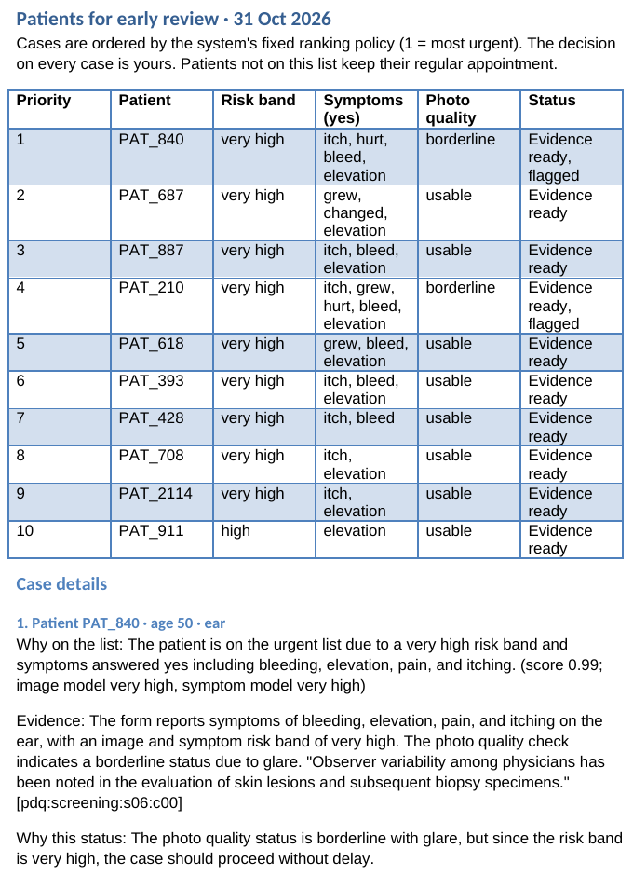



The morning report
07 · THE OUTPUT
Ten patients, in order
Cited evidence per case
The doctor ticks a decision
Notes:
Real output, not a mock-up: the Word report from the validation run of 31 October (PAD validation patients). Patient 1 had a borderline photo with glare but a very high risk band, so the agent proceeded with a flag instead of delaying with a retake. Each case shows why it is on the list, a verbatim NCI PDQ quote with its chunk id, and decision boxes: move earlier, approve a biopsy referral, keep the regular appointment. Live demo: run the CLI on the validation list. Recorded backup: this report plus the no-agent version, which shows the system works when the LLM is down.

Slide 8

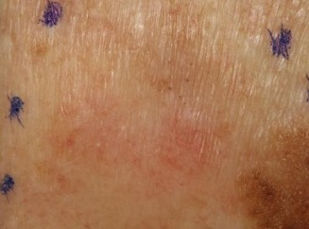
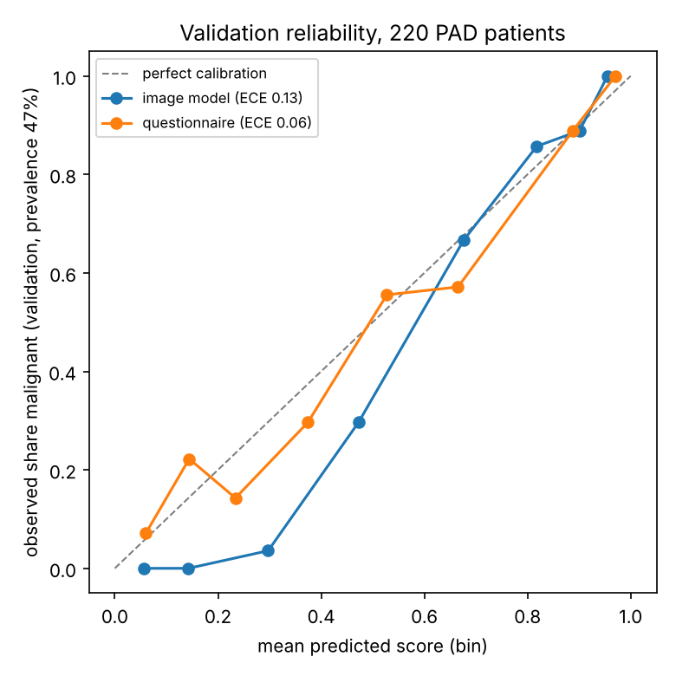
Strengths and risks
08 · STRENGTHS AND CHALLENGES
Zero leakage
Test opened once
Works without the AI
Cheap to run
11
+2
Ink = cancer?
Score ≠ chance
Dark skin
Benign wait
Shortcut not yet checked
Ranks only, never shown
images in all of PAD
days, if slots are not added
Notes:
Strengths: patient-level splits with zero leakage, asserted in code; the test set opened once on frozen decisions; the system runs without the agent; a few dollars a month. Risks, each with its reason. Ink: doctors mark lesions before biopsy and every PAD cancer was biopsied, so the model might learn that ink means cancer; this real training photo shows the marks; the blind labelling sheet is ready but not filled. Calibration: a score near 0.3 corresponds to about 4% malignant, and PAD is 47% malignant versus 10% in the clinic, so scores are used only as ranks. Dark skin: 11 images in all of PAD, so no claim can be made. Benign patients wait two days longer when priority slots are taken from existing capacity. Also: only 7 melanoma patients in the test set, and patient selfies will be worse than PAD’s clinical photos.

Slide 9
What we get, what it costs
09 · ROI AND NEXT STEP
VALUE · per month
COST · per month
PRICE · trade-off
~134
$3–6
+2
cancer patients seen about 3 weeks sooner
LLM; models run locally · ≈ 2–5¢ per patient moved up
days for benign patients, unless slots are added
Next: silent pilot
1 · Check ink
2 · Quality model
3 · Shadow mode
4 · Add slots
Simulated clinic: 100 arrivals/day, 10% malignant, 22 days → 220 cancers/month × 61% reaching a slot; median 24 → 1 day
Notes:
How the numbers are built, so you can defend them. Value: the M1 simulation assumes 100 arrivals a day and 10% prevalence, so about 220 cancer patients a month over 22 working days; 61% of them reach a priority slot, about 134, and their median wait drops from 24 days to 1, roughly three weeks. Cost: about $3–6 a month for the LLM at Flash-Lite list prices, or free tier; models and search run locally; so a few cents per cancer patient moved up. The real cost is dermatologist time for 10 reviews a day, which the system reorders rather than adds. Price: when the priority slots are taken from existing capacity, benign patients wait two days longer; funding extra slots removes that. Next step and readiness: technically ready for a pilot, clinically not. First check the ink shortcut, then build a photo-quality classifier, then run in shadow mode on real app photos without changing any appointment (including dark skin), and finally add priority slots rather than reallocate them. We deliberately did not convert this into dollars saved: there is no defensible per-patient money figure in our data.

Slide 10
10 · SUMMARY
The model ranks.
The agent explains.
The doctor decides.
Thank you · Questions
Notes:
Summary in three sentences. What we did: ranked a dermatology waiting list from a phone photo and six questions, with a guarded, grounded agent and a daily report. Why it matters: in simulation the median cancer patient is seen the next day instead of in 24 days, at a few dollars a month. What we learned: baselines and frozen decisions keep results honest, rules belong in code, and capacity, not AUC alone, sets the ceiling. Likely questions: leakage (slide 4), why the agent loses to if-else (slide 9), calibration and ink (slide 11), why the 90% sensitivity target was missed (slide 7).

